Slide 1
Welcome to Javascript

Slide 2
Array Methods
slice():
The slice() method slices out a piece of an array into a new array
The slice() method does not remove any elements from the source array.
const fruits = ["Banana", "Orange", "Lemon", "Apple", "Mango"];
const citrus = fruits.slice(2);
//slice() method can take two arguments like slice(1, 3)
const citrus = fruits.slice(1,4);
Sorting an Array:
The sort() method sorts an array alphabetically
Reversing an Array:
The reverse() method reverses the elements in an array
const fruits = ["Banana", "Orange", "Apple", "Mango"];
fruits.sort();
const fruits = ["Banana", "Orange", "Apple", "Mango"];
fruits.reverse();

Slide 3
Array Methods
indexOf():
searches an element of an array and returns its position
//finding the index position of string
const position = dailyActivities.indexOf('work');
console.log(position); // 2
includes():
The includes() method returns true if an array contains a specified value
const fruits = ["Banana", "Orange", "Apple", "Mango"];
fruits.includes("Mango");
isArray():
Check if an object is an array
const fruits = ["Banana", "Orange", "Apple", "Mango"];
let result = Array.isArray(fruits); // true
let text = “testStringArray";
let result = Array.isArray(text); // false

Slide 4
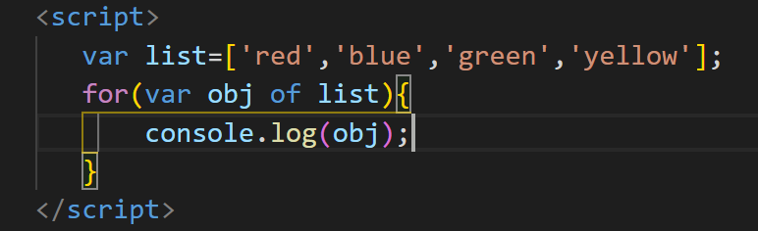
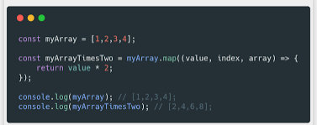
Array Loops – For & Foreach
for:
const fruits = ["Banana", "Orange", "Apple", "Mango"];
for (let i = 0; i < fruits.length; i++) {
console.log(fruits[i]);
}
foreach():
const fruits = ["Banana", "Orange", "Apple", "Mango"];
fruits.forEach(function(item){
console.log(item);
})

Slide 5
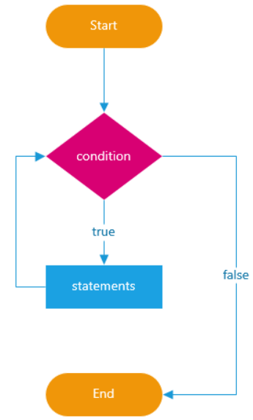
JavaScript Loops
In programming, loops are used to repeat a block of code
For example, if you want to show a message 100 times, then you can use a loop. It's just a simple example; you can achieve much more with loops.
For loop
While loop
do while

Slide 6
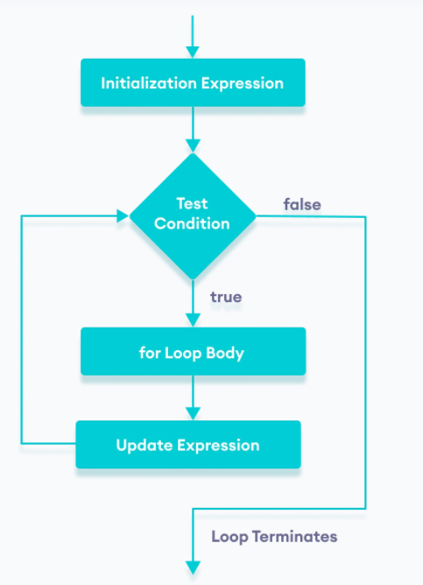
JavaScript Loops - for
The for loop requires following three parts.
Initializer: Initialize a counter variable to start with
Condition: specify a condition that must evaluate to true for next iteration
Iteration: increase or decrease counter
Syntax
for(initializer; condition; iteration)
{
// Code to be executed
}
Example
for (var i = 0; i < 5; i++)
{
console.log(i);
}
let n = 5;
// looping from i = 1 to 5
for (let i = 1; i <= n; i++) {
console.log(`I am learning JavaScript.`);
}

Slide 7
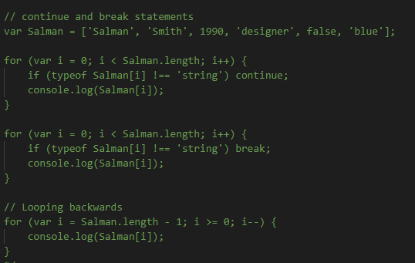
Continue and break statement

Slide 8
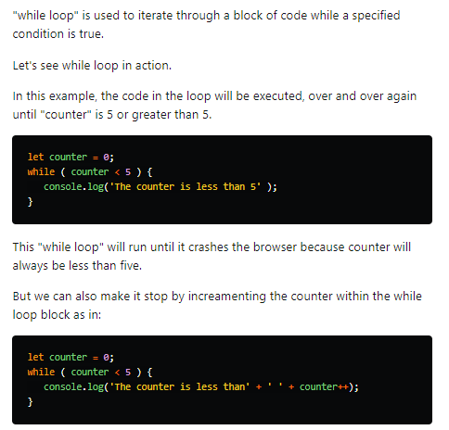
While Loop

Slide 9
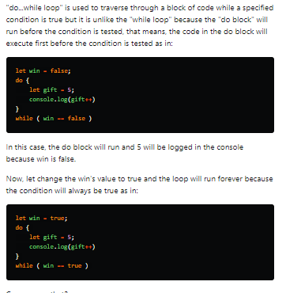
Do While Loop

